Slide 1
Research: Background & Plan
Presented by:
Kourosh Meshgi
Committee:
Prof. Ishii
Prof. Maeda
Dr. Oba
Presented as a part of fulfillment to be accepted as a member of Ishii Lab, Kyoto University

Slide 2
Content
0
Background
Vision in Human Brain
Efficient Coding Theory
Motivation
Natural Pictures
Methodology
Statistical Characteristics
Models
Bottom-Up
Top-Down
My MSc Thesis
Future Plan
Research
Laboratory Roadmap

Slide 3
Background
1
Vision in Human Brain
Brain Parts
Ventral Pathway
Research Approaches
Efficient Coding Theory
Motivation

Slide 4
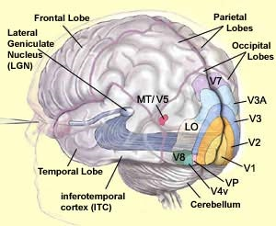
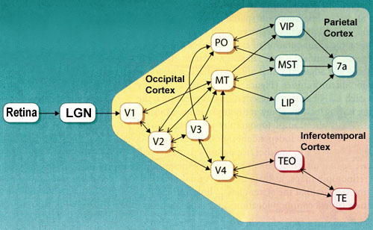
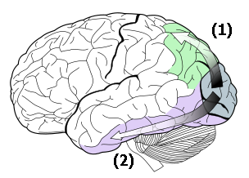
Visual Pathways
Hierarchical, Pyramid, Topographic and Parallel Pathways

Slide 5
Ventral Visual Pathway
Conscious Cognition, Recognition and detection of objects based on their visual intrinsic properties (e.g. color and shape)
Optic Nerve
LGN
V1
V2
V4
IT

Slide 6
Study Approaches
Studying Brain Parts
fMRI
Studying Behavior of Neurons
Single Cell Recording
Studying The Effect of Lesions to Brain Functionality
Using Models to Predict Characteristics
Targeted Non-Random Stimuli
Complex Stimuli for Higher-order Neurons to handle Invariances

Slide 7
Efficient Coding
Observation: High volume of Input Information, Slow Processing in Higher-order neurons
Sensory Cortex → Process Input Data → Result
No Redundancy
Volume proportional to Input
Limitations
Code Efficiency
How the code is related to the message it conveys
Neural Code: neural representation based on structure of input data
No optimal code for all information
Visual System → Input Statistics → Natural Scene → Optimized Coding System → Reveal Characteristics of Human Brain Visual System

Slide 8
Natural Image Statistics: Why
Primary Visual System Objective Functions
Coding Mechanism
Calculation Biological Limitations
Coverage of Statistical Regulations by the Response Properties
Evolution Pressure on Biological Systems
Efficient Codes
Information Theory:: The more efficient codes, the better it capture statistical regulations
Important Visual Tasks
Interesting Features
Filling Information Gaps

Slide 9
Natural Pictures
2
Methodology
Statistical Characteristics
Single Pixel
Second-Order
Higher-Order
Variance Dependency
Class Dependency

Slide 10
Image statistics
Image Space
Natural Images
P(x)
Could be defined by deterministic function…
Better described by Soft memberships, using probability is preferred

Slide 11
General Methodology
Observation of “Suspicious” Coincidences
Optimal Representation

Slide 12
Single Pixel Statistics

Slide 13
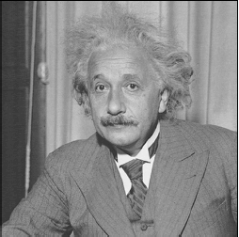
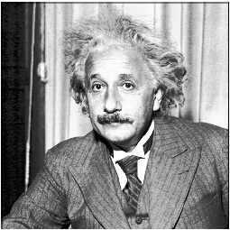
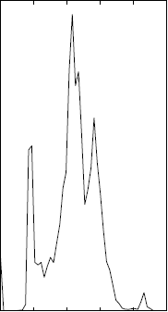
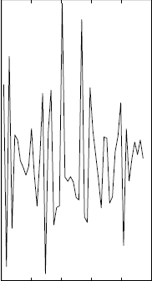
Histograms?!
Image
Histogram

Slide 14
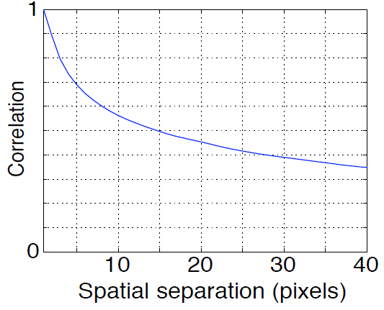
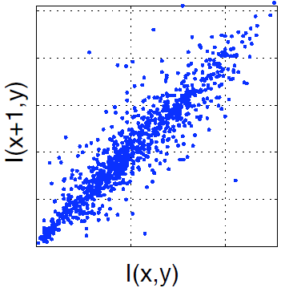
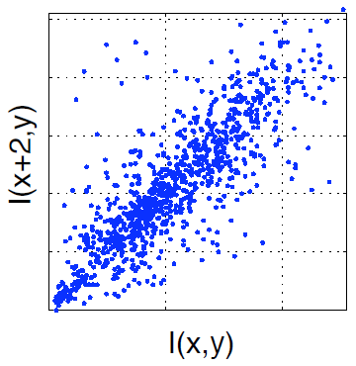
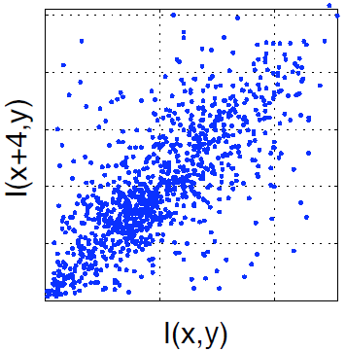
Pixel Correlation

Slide 15
Second Order Statistics

Slide 16
Higher Order statistics

Slide 17
Biological Limitation
Multi-Scale Nature of Primary Visual System
Spatiotemporal Adjustment in V1 simple cell
Variety in Receptive Fields
Neurons don’t have ∞ precision
Limited to a bit per a spike in neuron response
Neuron Population
Reconstruction error could be reduced to an arbitrary value increasing the neuron count

Slide 18
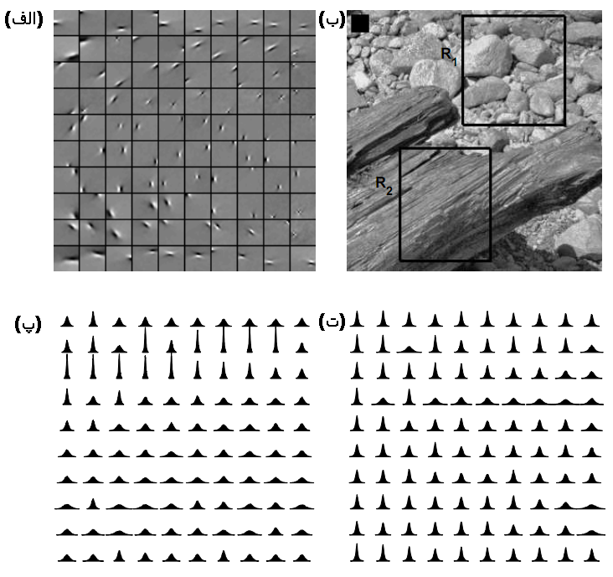
Context Dependency

Slide 19
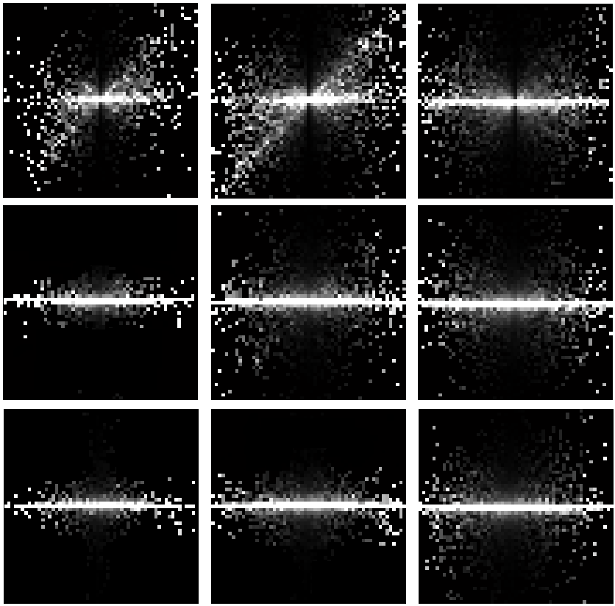
Class dependency

Slide 20
Statistical Regulations
Second-Order Regulations
Non-orthogonal
Context & Class Dependency
Scatter Directions

Slide 21
Models
3
Bottom-Up
Definition
VisNet Models
Cortical Maps Model
HMAX Model
Malmir Model
Top-Down
Chronology
Hierarchical Structure
Variance Dependency
GSM Hierarchy
Covariance Dependency
My MSc Thesis

Slide 22
Bottom-Up Models
Visual Tasks is explained using a few neuron properties, their arrangement, interconnection, and learning rules.
Neuron Properties
Arrangement and Inter Connection
Cognition

Slide 23
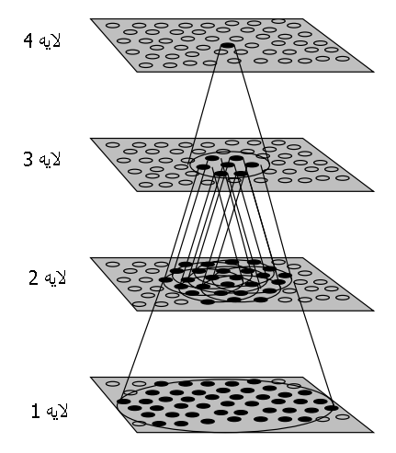
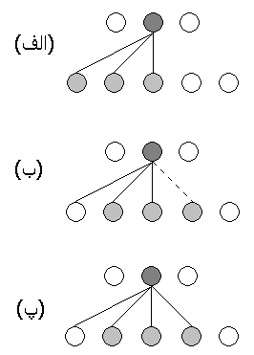
VISNET MODEL

Slide 24
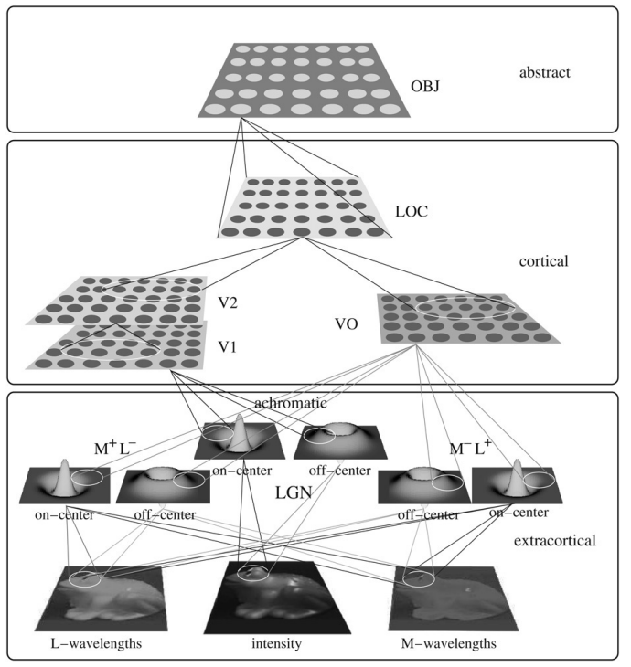
Cortical maps model

Slide 25
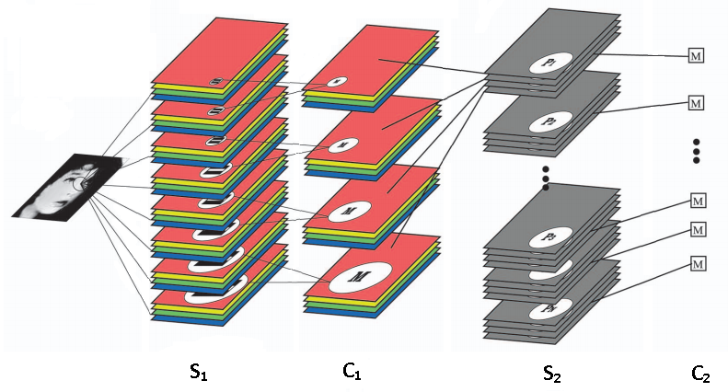
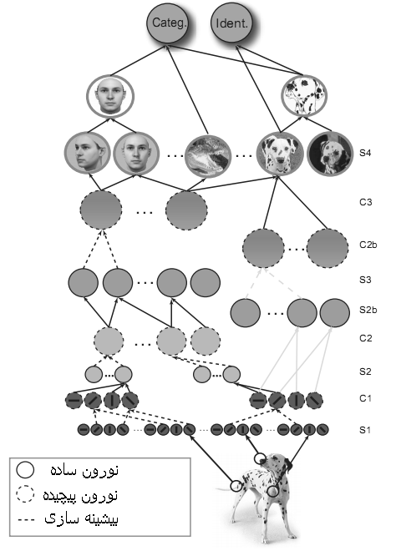
HMAX Model

Slide 26
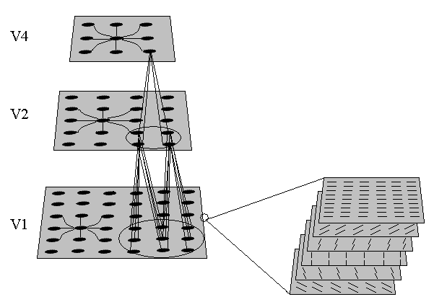
Malmir model

Slide 27
Top-Down Models
Visual Tasks parameterize rules governing neurons and neuron characteristics.
Inverse function of data generative models: Model is known, visual system is to infer parameters and latent variables which generate data.
Constraint satisfaction models: Objective function is known (e.g. decorrelation or maximum data transfer) and visual system optimize neurons interconnection to optimize objective function regarding its constraints.

Slide 28
Model Chronology
Gaussian Model
Principle Component Analysis
Correlation Model
Independent Component Analysis
Sparse Coding
Wavelet Marginal Model
Gaussian Mixture Scale Model

Slide 29
Hierarchical Models
Variance Dependency Hierarchical Model
GSM Hierarchical Model
Covariance Dependency Hierarchical Model

Slide 30
Variance dependency

Slide 31
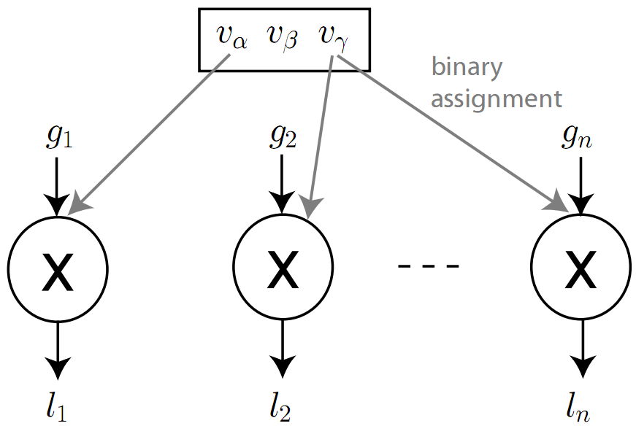
GSM Hierarchy

Slide 32
Covariance dependency

Slide 33
Local dependencies

Slide 34
My MSc Thesis
Distribution Coding of Input Image
Finds the most similar distribution that matches the Input Data
Relaxing the Need of Fixed Linear Transformation
Adjustable Weights
Relaxing the Need of Fixed Basis Function
Gaussian Basis Function (parameterized)
Generalization Mechanism over Local Dependencies using Inference
Maximum A postriori
No Locality Assumption

Slide 35
Distribution coding

Slide 36
Distribution coding

Slide 37
Distribution coding

Slide 38
Distribution coding

Slide 39
مدل کدگزاری توزیع

Slide 40
Results on natural Images

Slide 41
Generalization and sepArability of result

Slide 42
Future Plan
4
Research
Areas
Requirements
Outcome
Laboratory Roadmap
Publication Timing
Strategy

Slide 43
Research Areas
Biological Visual Systems
Visual Cortex
Evolution
Top-Down and Bottom-Up Models
Ventral Pathway
Object Recognition
Evaluation Process
Machine Vision Means
Neuroscientific Experiments

Slide 44
Research Requirements
Courses
Mathematics Non0linear Optimization
Neuroscience Foundations
Advanced Statistics
State-of-the-Art Books and Publications
Friendly Environment
Trust
Basic Workspace Requirements (Web Space, …)

Slide 45
Research Outcome
A realistic model that overtake present models in justifying biological phenomena such as nonlinearities in primary visual cortex as well as a model for higher visual areas

Slide 46
Publication Timing
Year 1:
Making a Framework for Evaluating Different Models (conference paper)
Year 2:
Survey on Top-Down Models (journal paper)
Year 3:
Final topics of dissertation (each topic: 1 conference paper)
Putting all research together (journal paper and then book chapter)

Slide 47
Plans
Making a Knowledge Wiki
Monthly Presentation for Lab members
Making Sophisticated Library (if not already presented)
Conducting Experiences with fMRI (if possible)

Slide 48
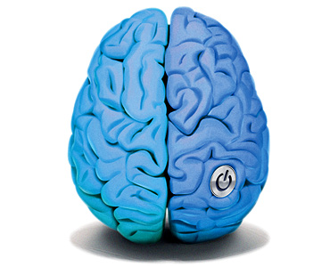
Questions
!
Question?
Thanks for your time…

